Slide 1
Are you an entrepreneur and don’t know what to do with your potential?
The European Language Label awaits your contribution to educational excellence.
Extremenian group of computer teaching assistant languages
http://gexcall.unex.es
Gemma Delicado, Eva Domínguez, Paula Ferreira, Pilar Reyes
Coordinator: Mercedes Rico (mricogar@unex.es)

Slide 2
INDEX
1 Introduction
2 The European Language Label in Spain
2.1. What is the European Language Label Award?
2.2. When is celebrated?
2.3. What are the objectives?
2.4. Categories
2.5. Modalities
2.6. Criteria to obtain the European Language Label
3 The Label Campaigns
3.1. Dissemination
3.2. Calls for Tenders
3.3. The selection of winning projects
3.4. The Awarding Ceremony

Slide 3
INDEX
4 Priorities
4.1. Language learning based on the new technologies
4.2. Multilingual Classrooms
4.3. Immersion programs and Language and Culture Bilingual Sections
5 Awarding the European Language Label
6 Evaluation and follow-up
7 Impact and exploitation of the European Language Label
8 Best practices at national level
9 Recommendations
10 Conclusions
11 Bibliography, references and acknowledgment

Slide 4
ABSTRACT
From this emerged the European Language Label, an initiative that seeks to promote language learning and address the students’ need for full European integration. Therefore, since 1998 the European Language Label has encouraged educational entrepreneurs to integrate their initiatives at both national and European levels. All these initiatives can be adapted to any context and language, so dissemination and promotion are important aspects of the project.
Considering the need to learn foreign languages for professional, occupational or personal development as well as the goal of lifelong language learning adopted at the Lisbon summit for education and training, it is possible that the demand for learning languages is set to increase dramatically leading to an increase in the development of innovative teaching practices.

Slide 5
ABSTRACT
language learning integrated into other content areas are the themes most frequently found among educational awards and prizes.
The aim of this paper is to report on the European Language Label, and in turn raise awareness and disseminate initiatives between educational institutions, primarily to take advantage of such work and adapt it to the needs of students, and secondly to encourage educational entrepreneurs to collaborate on future projects.
Within education, Information Technology and Communication have become an essential element in the development of students’ skills, so ICTs for language learning immersion should count among the priority projects at European level. Along with technology, language immersion programs, multilingualism and

Slide 6
The European Language Label in Spain
What is the European Language Label Award?
The European Language Label (ELL) is an award which encourages initiatives in the field of teaching and learning languages and is intended as a tool that can help teachers and learners become more aware of innovative initiatives in the field.
The ELL aims to inspire teachers and learners to adapt innovative and effective ideas and techniques, in accordance with their own needs.

Slide 7
The European Language Label in Spain
When is it celebrated?
The Ministry of Education, Culture and Sports convenes the awards annually, usually between March and July, and establishes the conditions.
The prize is called "European Label for innovative initiatives in teaching and language learning: an invitation to apply for the European Label.”

Slide 8
The European Language Label in Spain
What are the Objectives?
The objective of the awards is to promote newly recognized examples of innovative practice in order to share experiences within the field of teaching and learning of languages.

Slide 9
The European Language Label in Spain
Categories
The European Language Label is open to four eligible categories:
Primary Schools (staff and pupils)
Secondary Schools (staff and pupils)
Post-Secondary/Tertiary Institutions (lecturers, administrative staff, students councils and organizations, faculties, departments and institutions)
Youth / Adult / Professional Organisations (voluntary organisations, local councils, companies, NGOs sport clubs, etc.)

Slide 10
The European Language Label in Spain
Modalities
This award recognizes innovative experiences in the field of teaching and learning of languages (including sign language), whether foreign, national, regional or migrant community initiatives. They have been awarded by Spanish government since 1998, and have been awarded in two modes since 2005:

Slide 11
The European Language Label in Spain
Modalities
Type A:
Institutions or educational and / or training authorities and associations that are developing initiatives to promote the teaching and learning of languages at all stages of education and training, formal or informal, regardless of the age of the students and the type of establishment concerned.
Type B:
Teachers of languages, for their dedication, personal commitment, minority language teaching, teaching in extraordinary circumstances.

Slide 12
The Label Campaigns
Dissemination in Spain
Among the main activities carried out by the Spanish Ministry and Spanish agencies and institutions for the dissemination of information of existing projects we highlight the following:
Dissemination of winners and the announcement of successive calls through the Government Gazette:
Example: http://www.boe.es/diario_boe/txt.php?id=BOE-A-2011-18798
Websites:
http://www.educacion.gob.es/horizontales/prensa/notas/2012/07/20120723-premio-sello-europeo-.html
http://www.oapee.es/oapee/inicio/iniciativas/sello-europeo/historico-premiados0.html

Slide 13
The Label Campaigns
Centers and institutions
http://www.educastur.es/index.php?option=com_content&task=view&id=3502&Itemid=237
Workshops and training sessions
The winning entries will be held by the Autonomous Agency for European Educational Programmes for dissemination through publication, to enhance the multiplier effect of these experiences due to their quality and didactic and methodological innovation.

Slide 14
The Label Campaigns
Most of the winning entries have been reported by the local press within the different regions in which they took place. For example:
http://www.elperiodicoextremadura.com/noticias/navalmoral/ies-augustobriga-recibe-premio-selloeuropeo-por-su-labor-con-los-idiomas_623352.html
Some of the works have also been included in the national press:
http://www.abc.es/agencias/noticia.asp?noticia=1029755
Social networks have contributed to raising awareness of different projects:
http://es-la.facebook.com/permalink.php?story_fbid=262516527140136&id=145635995494857

Slide 15
The Label Campaigns
Calls for Tenders
Interested parties submit their application and attach the required documentation as specified in the Government Gazette. The last call was on July 3, 2012. More information at:
http://www.oapee.es/dctm/weboapee/selloeuropeo/convocatoria-2012.pdf?documentId=0901e72b813d0a14
A summary of all calls is available here
http://www.oapee.es/oapee/inicio/iniciativas/selloeuropeo/convocatoria.html

Slide 16
The Label Campaigns
Calls for Tenders
The request may be submitted at any Public registry and should be addressed to the Ministry of Education of the Autonomous Communities. By clicking the link below you will find a directory with the European Label Units: Responsible Education Authorities for European Labels
http://www.oapee.es/oapee/inicio/iniciativas/sello-europeo/contacto.html

Slide 17
The Label Campaigns
The selection of winning projects
For projects to be eligible for European Language Label, they have to prove they are innovative, effective and transferable to other contexts. The initiatives should incorporate a new method or approach, or improve past performance. They should also demonstrate students’ progress.
Jury: The selection process is conducted by a jury, composed of the following members:
President: The Director of the Autonomous European Educational Program.

Slide 18
The Label Campaigns
Vice: The Director of the Division of Comenius-Grundtvig Autonomous Agency for European Educational Programs, which may replace the President in case of absence.
Members:
A representative of the General Secretariat of Universities.
A representative of the General Directorate of Lifelong Learning.
A representative of the National Institute of Educational Technology and Teacher Education.
A representative of the Directorate for Overseas Education.
A representative of the General Directorate of Territorial Cooperation.
Two representatives from the Ministry of Education of the Autonomous Communities.
Two representatives of the Autonomous Agency for European Educational Programmes, one of whom shall act as Secretary.

Slide 19
Priorities
Language learning based on the new technologies
Technology influences many aspects of our lives, language learning included: computer and/or technology-assisted language learning and testing, blended language learning, virtual and distance learning have become very useful tools to teach and learn foreign languages efficiently. The creation and educational use of social networks also boosts the fostering of multilingual engagement and participation across boundaries, and represents a means to interact and to learn foreign languages.

Slide 20
Priorities
Language learning based on the new technologies
This innovative learning/teaching system should combine the inspiration and motivation of traditional classroom teaching and the flexibility of online or distance learning to create courses that are accessible and motivating for today's students, who develop their autonomy, interact by way of a computer with teachers "on the other side of the screen" and have fun while learning a foreign language.

Slide 21
Priorities
Multilingual Classrooms
The racial and cultural map of European countries has changed in recent years. This change is especially evident in Spain, a country unaccustomed to immigration. The educational community has been one of the most affected by these changes. Thus, the incidence of multilingual classrooms is increasing continuously

Slide 22
Priorities
Immersion programs and Language and Culture Bilingual Sections
Although they may have different forms, some of the winning initiatives could include:
Language learning courses where participants who wish to learn a foreign language (students) live together for a period of time with native-speaking volunteers who want to learn their language. During this coexistence, students participate in joint activities aimed at improving their communication skills.
Kindergartens, Primary and Secondary schools who teach at least two subjects or areas in a foreign language. In our region, the bilingual sections are English, French and Portuguese.

Slide 23
Award of the European Language Label
Since the beginning of the European Language Label a common feature of every edition of the initiative has been the improvement of language learning, bringing Europe closer together through increasing understanding the diversity of languages and cultures among and within member states.
In Spain winning initiatives are from 1999 to the present are available at www.oepee.es/oapee/inicio/sello-europeo/historico-premiados0.html
The analysis of these initiatives provides an overview of the priorities taken into account when each European Language Label was awarded.

Slide 24
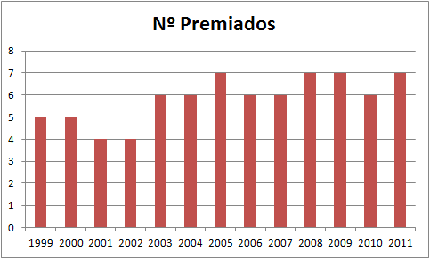
Award of the European Language Label
Through historical analysis of the granting of this award we can make the following observations:

Slide 25
Award of the European Language Label

Slide 26
Award of the European Language Label

Slide 27
Award of the European Language Label

Slide 28
Evaluation and Follow-up
The first step taken was the analysis of all awards granted in Spain and Portugal over the last 10 years (2011-1999). This first step was called:
Project NELLIP WP1 - Case Studies
This is followed by a series of guidelines:
http://www.oapee.es/oapee/inicio/iniciativas/sello-europeo/historico-premiados0.html
In the first analysis we selected 25 initiatives. Each group member selected between 2 and 5 initiatives.

Slide 29
Evaluation and Follow-up
All the information collected was recorded in a document called "European Label: basic information“ which allowed categorization and cataloging of the selected projects. In this first selection 12 initiatives were categorized by country and are available via the following link: http://nellip.pixel-online.org/CS_lista.php
After this initial selection four of the best initiatives were selected. To do so the co-coordinators of each of the 25 projects were contacted and interviewed. In addition to the interview, the level of coverage of each project in the press and scientific papers was also taken into account.

Slide 30
Evaluation and Follow-up
NELLIP WP1 Project - Best Practices
Tracking practices were carried out as follows:
Complete study of each projects and the results.
Interviews with coordinators.
Analysis of diffusion: newspaper articles and scientific production.
Both the evaluation and follow-up were conducted in conjunction with the Ministry of Education.

Slide 31
Impact and use of the European Language Label
In most of the selected examples of good practice, the co-coordinators the following assessed the following aspects concerning the impact of the award:
Confidence in the undeniable ability of the project to improve and develop language learning and teaching.
Thanks to the award many projects have become tools available to the wider teaching community.
Demonstrated the democratic and universalist philosophy underlying the winning projects.

Slide 32
Impact and use of the European Language Label
In some cases, the award has served to help improve educational institutions in danger of marginalization.
The award has served to convey to the educational community the importance of such initiatives for universal education.
Winning an award helps motivate the innovative work of teachers and institutions who have worked hard to enrich their educational programs and the quality of their teaching.

Slide 33
Best practices at national level
The best practices in Spain were selected in collaboration with the Spanish Ministry of Education as already mentioned above.
School education: ALEHOP: programme for the Development of Communicative Skills
Adult educatiom: E-tridem.net. Intercambios Interculturales en Entornos Virtuales
Higher education: Le tour de France
Vocational Education and training: Taste of the Language

Slide 34
Recommendations
During the interviews with the project coordinators, most recommended:
To keep working for a better world from a collaborative and interdisciplinary perspective.
To increase awareness of good language learning practice in Europe through programs’ web page to continue learning from other excellent projects.
To teach languages using global methods that are able to react to universal needs and to motivate teachers to continue to transfer knowledge to enrich perspectives.

Slide 35
Recommendations
Among the suggestions offered by the project coordinators some of the most interesting include:
Publish the criteria to be met by candidates for European Label awards well in advance as they are different each year and these criteria are of great help when planning the structure of the project to be submitted.
Increase dissemination of these experiences through media interviews, participation in conferences or publishing articles in journals.
Develop quick tips on how to plan and develop quality learning experiences for language learning based on initiatives that have achieved a European Label award.

Slide 36
Recommendations
Conduct training for teachers using based on the experiences of award winning initiatives. Most relevant aspects for future ELL award participants:
That participants involved in innovative and creative projects know that what they do is what needs to be done, to feel the excitement for and pride in their project. It is a means to demonstrate the great quality work taking place in education to improve language teaching and learning.
That the important thing is not the European label itself, but the ideas and projects presented and how they work in the classroom to achieve the learning objectives.

Slide 37
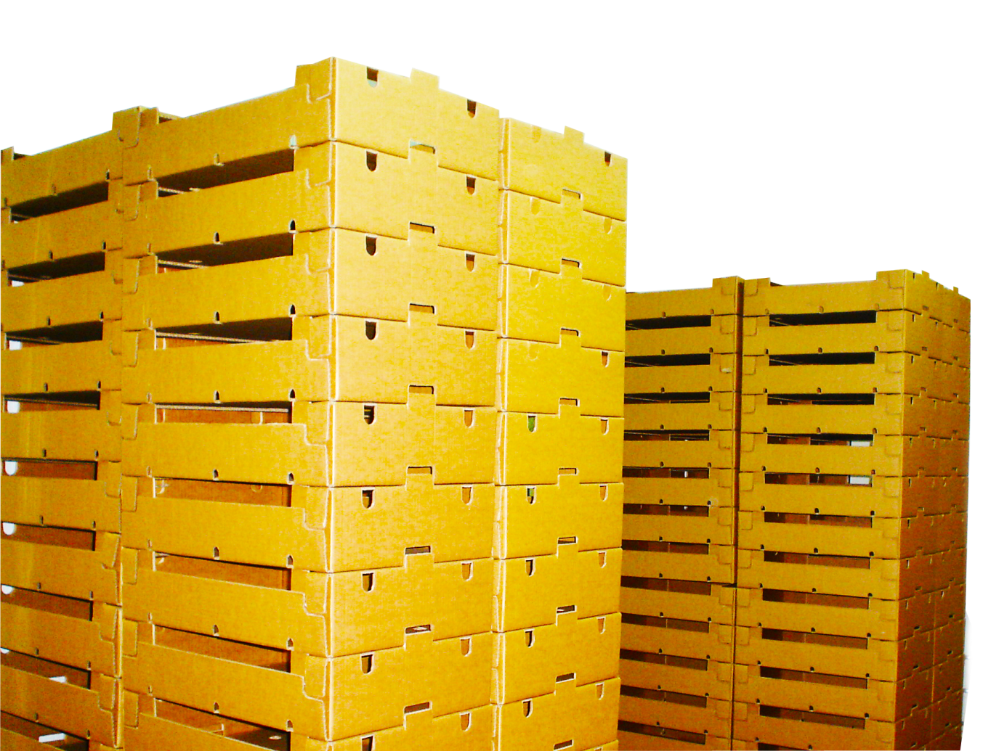
Work Packages University of Extremadura
(Spain)

Slide 38
Activities to be carried out in the framework of WP1
Activity 1.1- Research
Research, identification and analysis of 50 language learning initiatives that were awarded the European Language Label
Activity 1.2 – Case studies
Availability of 24 Case studies (3 for each of the 4 thematic areas - i.e. School education, Higher Education, Adult Education, Vocational Education and Training -for each of the 2 countries).
We regret to inform you, there are only three available case studies in Portugal, promoters and coordinators are not willing to participate in the project.
According to Spanish case studies, the remaining project (Web del Observatorio Atrium Linguarum) will be updated in a couple of days.

Slide 39
Activities to be carried out in the framework of WP1
Activity 1.3 – Good Practices
Identification, for each of the 4 thematic Areas (i.e. School education, Higher Education, Adult Education, Vocational Education and Training) in each of the 2 European countries (own country and selected neighbor country), of 1 good practice that will be selected out of the case studies produced.
We are waiting the national agency feedback on the selected best practices.

Slide 40
Activities to be carried out in the framework of WP1
Activity 1.4 - Production of National Reports
Production of two National Reports that will present the European Language Label in both countries analyzed.

Slide 41
Activities to be carried out in the framework of WP4
Activities 4.1 - Translation of Portal contents
Translation of the main texts of the portal into the national language

Slide 42
Activities to be carried out in the framework of WP5
Activity 5.1 – Project meetings
Participation in Partners Meetings.
1st Meeting: Florence, February 2012
2nd Meeting: Florence, November 2012
Activity 5.2 – Project Activities Reports
Production and uploading of in progress Project activities reports.
30 March 2012
30 June 2012
30 September 2012

Slide 43
Activities to be carried out in the framework of WP7
Activity 7.1 – Dissemination events
Organization of 2 dissemination events on the project every month and filling in of dissemination report forms on the website.
30 March 2012
30 June 2012
30 September 2012

Slide 44
Activities to be carried out in the framework of WP8
Activities 8.1 – National Agencies involvement
Involvement of the National Agency in charge of the national management of the European Language Label
Activity 8.2 – Associated Partners
Involvement of at least 10 organizations operating in the field of economy education and/or language learning for specific purposes as Associated Partners of the project.
10 letters of participation (5 Year 1 + 5 Year 2)
10 Associated Partners (5 Year 1 + 5 Year 2)

Slide 45
Conclusions
Our team, an innovative and multidisciplinary group that belongs to the University of Extremadura, together with the Ministry of Education have selected the language learning initiatives that have been awarded the European Language Label.
After several months of study, selection, and analysis, we present the four best practices. These correspond with the best winning initiatives in Spain since the beginning of the European Language Label in 1998 up to and including 2011 and reflect the political priorities of the European Commission in the field of language learning.

Slide 46
Conclusions
Most project coordinators selected have shown their support for the annexation by NELLIP of the project by providing information concerning their initiative. Through their participation they will also gain a better understanding of all the award winning projects throughout Europe and gain official European recognition.
In addition to the support we have received for the coordinators we have also received letters from other institutions demonstrating their interest in the project and desire to benefit from the results of the analysis in order to enrich their teaching practice.

Slide 47
Conclusions
They include:
Centros de Profesores y Recursos (Mérida)
Escuelas oficiales de idiomas
Fac. Formación del Profesorado, Universidad de Extremadura, Cáceres
CEIP Santísimo Cristo de la Salud (Hervás)
Universidades extranjeras (Wofford College, Spartanburg, South Carolina, EE.UU)
Instituto de Tecnología, Electrónica, Informática y Comunicaciones (Badajoz)
Academias de inglés: Dickens Institute, (Mérida)
Fundación Fesord (Valencia)Escuela Oficial de Idiomas de Salamanca
Escuela Oficial de Idiomas de A Coruña
Escuela Oficial de Idiomas El Fuero de Logroño (Logroño)
SAI SUR Madrid (Servicio de Apoyo al Alumnado Inmigrante)
CEIP León Solá (Melilla)
CEIP Pedro de Valdivia (Castuera)
Espacio Joven (Ayuntamiento de Cartagena)
Asociación ATIFE (Córdoba)
IES AGUSTÓBRIGA (Navalmoral de la Mata)
IES AGUSTÓBRIGA, (Andújar)
Organismo Autónomo Programas Educativos Europeos (OAPEE)
Ministerio de Educación, Cultura y Deporte

Slide 48
Conclusions
The main advantages of the European Language Label contained in this report are: to improve the visibility of the selected projects and to encourage prospective applicants to apply for the award - too many projects do not come to light as the participants are unaware of its existence. In this way we aim to provide more opportunities for language learning. This study of the initiatives has also served as a form of quality assessment.
We hope that with this project (NELLIP), the European Language Label becomes more widely known and teachers become more involved in creating a greater number of initiatives to improve language learning that improve on existing ones. We hope this report will help many prospective applicants have a clear outline of the opportunities provided by an award of this type.

Slide 49
thanks

